Slide 1
WORKFORCE LONGITUDINAL DATA SYSTEM
Community College Services Group
8-08-14

Slide 2
History

Slide 3
SLDS
Longitudinal Data System grants were awarded by the US Department of Education to Michigan in 2005 and 2009
Designed to link pre-K - 12 student records with higher education.

Slide 4
WLDS
The US Department of Labor awarded a Workforce Data Quality Initiative grant to Michigan for 2012-2015
Designed to integrate workforce data with the LDS.

Slide 5
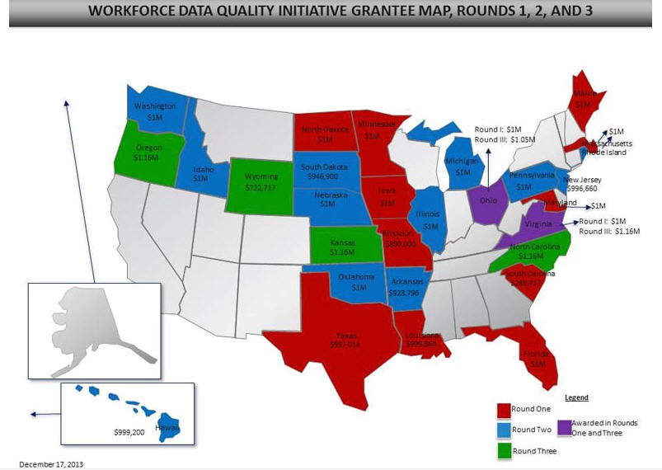
Notes:
Michigan was round 2 and 4 states have expansion grants.

Slide 6
Grant Goals

Slide 7
Our Mission
Create partnerships with other state agencies to integrate data sharing.
Develop data exchange technologies and capabilities.
Ensure participant anonymity and privacy protection.
Detail system fields to integrate information for data processing.

Slide 8
Linking WLDS and SLDS
Workforce Investment Act Records
SLDS (Pre-K through 12 Education, Community College and Public University Records)
Trade Adjustment Assistance Records
Unemployment Wage Records
Labor Market Information
Data Sets Linked via Unique Identification Codes/SSNs
Wagner-Peyser Records
Unemployment Benefit Records
TANF and SNAP Work Participation Records
Adult Basic Education Records

Slide 9
OSMIS
3.1 million unique records
Michigan Works! walk-ins
Enrolled dislocated workers, DHS clients, veterans, trade assistance members,
migrant seasonal farmworkers, adults, and youth
1999+

Slide 10
MSDS/STARR/NSC
5.3 million unique UIC records
Early Childhood, Early On, K – 12
2002+
634,542 unique post-secondary records.
2009+

Slide 11
Matching Process
3,077,148 records have been processed with the MSDS system
934,000+ matched through automatic process
61,000+ needed to be manually assessed

Slide 12
Data to Stakeholders
What is the ROI…
Does training in…
Where should I…
How many…
How much…

Slide 13
What colleges have graduates that possess the skill sets we need?
employers

Slide 14
taxpayers
Does program/state investment in education increase a participant’s likelihood of employment or degree completion?

Slide 15
parents
What college has the highest employment/wages for graduates with a forensic science degree?
Notes:
2yr, 4yr, or cert would be best.

Slide 16
academia
How many Bachelor degrees are obtained in Agriculture?
How many high school dropouts go on to obtain a higher degree?

Slide 17
policymakers
What programs and focus are the most successful in terms of degree and employment attainment?
What impact does receiving state assistance have on obtaining post-secondary degrees?

Slide 18
students
How much money can I make with a welding certificate in Wayne County or Ingham County?
What is the average amount of time between graduation and getting hired for graduates in my field?

Slide 19
teachers
Where should I steer students who are interested in science fields?
How can my students compare employment expectations for their interests?

Slide 20
In Process…
Defining data needed to answer Core Questions with 40+ tables
Developing master file with data elements linking OSMIS systems

Slide 21
Creating interactive tables on the Workforce tab of the MI School Data portal.
Constructing white papers to answer the grant questions and compare our results to state averages

Slide 22
WLDS Next Steps
Michigan Dept. of Education – CEPI to capture career and technical education (CTE) data
GED – OSMIS to expand secondary completion information

Slide 23
University of Michigan Study 2011
Objective:
To estimate economic returns in terms of employment and earnings on programs offered at community colleges.

Slide 24
Provided aggregated outcome data (Wage Record and UIA records) to Macomb, Jackson, Lake Michigan, Washtenaw, and Oakland community colleges for their graduates.
2014 Proposal- expand to all community colleges

Slide 25
Population Expansion
Secretary of State –
(Proposed) connect wage record to education data without attachment to workforce.

Slide 26
Questions?
Jeni Spaulding, Departmental Analyst
Vern Westendorf, WLDS Manager
Workforce Development Agency, State of Michigan
Victor Office Center | 201 N. Washington Square, 5th Floor |
Lansing, MI 48913
Phone: 517-335-1543 | Fax: 517-241-8217 |
westendorfv@michigan.gov

