Slide 1
The Futures of the Community College
Creating Our Possible Tomorrows, Today
Michigan Community College Annual Data Workshop
August 8th, 2014
Notes:
By examining trends and issues that impact the college we have the ability to create multiple futures.

Slide 2
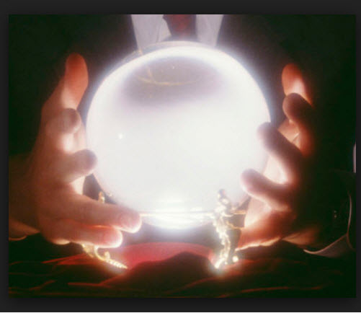
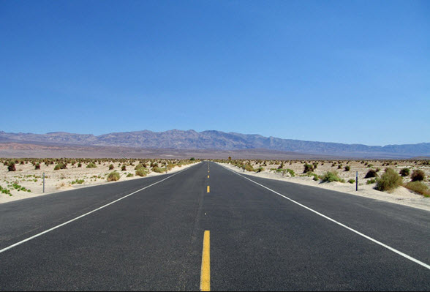
The future is not predictable, but we do have the ability to anticipate and shape it if we watch for changes on the horizon.
Notes:
There is no crystal ball. But we can choose to take the “long view” and embrace changes on the horizon.

Slide 3
In order to be open to change one must “suspend disbelief”
Notes:
For one to be open to the future, one must not say, “that will never happen.” Twenty years ago who would have thought GR would be …

Slide 4
Environmental Scanning Information presents community colleges with opportunities and challenges by looking at the forces of change outside of the walls of the college.

Slide 5
Community College Trends
Increasing use technology
Expanded learning environment (at home, industry, school)
Increasing numbers of underprepared students
Widening group of haves and have nots (in U.S., globally)
Increasing need for cooperation at all levels of education, business, and government
Increasing loss in high paying jobs

Slide 6
Community College Trends
Increasing need for alternative systems of instructional delivery, scheduling, distance learning
Declining resources for community college education
Increasing diversity of the student population on campus
Changing public expectations
Increasing questioning of the value of community colleges
Increasing community college "boundaries"

Slide 7
Critical Trends and Events Affecting Community Colleges Proceedings of a Beyond 2000 Preconference Workshop Beyond 2000: Visioning the Future of Community Colleges The 1995 Inaugural Futures Assembly February 26-28, 1995 Orlando, Florida

Slide 8
Factors that Frame the Future
Resources
Technology
Demographics
Governance
Notes:
There are four factors that help us frame the future if we pay attention to the changes they present.

Slide 9
Resources
Notes:
Most of us think of natural resources or raw materials when we think of resources.

Slide 10
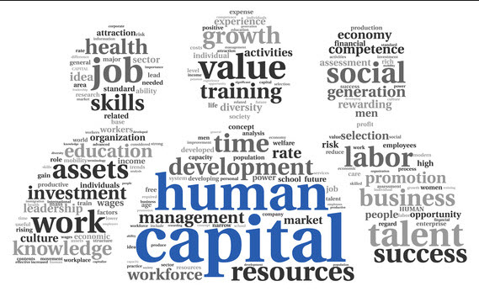
Resources
Financial
Federal, State, and Local Funding
Tuition and Fees
Grants
Alumni and Donors
Human Capital
Faculty
Staff
Students
Notes:
For a community college dollars and people are our resources.

Slide 11
Resources
Students
Opportunity Nation has created an Opportunity Index using indicators for:
Economy
Education
Community Health and Civic Life
Michigan Ranks 35th in the Nation
Notes:
Click on the links to learn more about Opportunity Nation and the Opportunity Index.

Slide 12
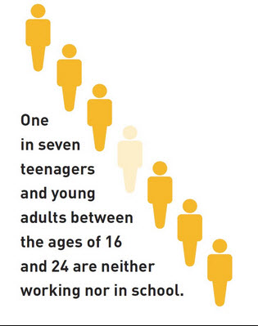
Resources
Students
Community Health and Civic Life
Indicator: Youth Not in School and Not Working (% of 16-24 Y.O.
Labeled: Disconnected Youth
Michigan % of youth not in school and not working = 15.4%
(National Avg. 14.6%)
Notes:
The disconnected youth in our communities are an untapped source of potential students.

Slide 13
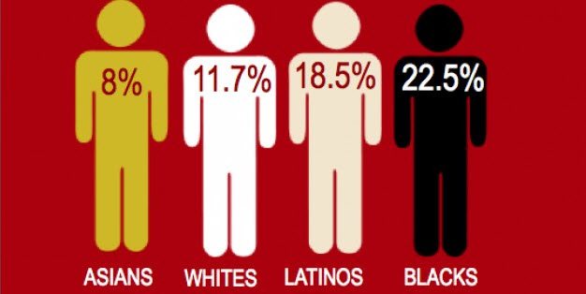
Resources
Disconnected Youth ARE Potential Students
In Michigan there are approximately 200,000 disconnected youth
If each community college enrolled an equal number of disconnected youth, each college would experience an increase in enrollment of over 7,000 students

Slide 14
Resources
Enrolling Disconnected Youth presents MI community colleges with huge opportunities, but also a huge challenges.
Notes:
Reconnection is hard work, but that work is being done at community colleges in our nation.

Slide 15
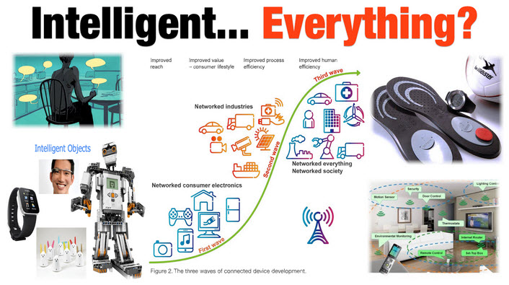
Technology
Technology
Technology
Notes:
The change that technology presents is continuous and rapid.

Slide 16
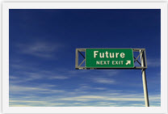
Technology
Information is a commodity
Learning is not a commodity
In the next 10 years Information Technology will change education as we know it
Notes:
We are coming to an era where information technology will not be used to maintain how we do things in a different format, but will be used to facilitate learning in new and innovative ways.

Slide 17
Technology
How fast is the Internet growing?
Notes:
For the answer click on the link.

Slide 18
Technology
Smartphones to Wearable Technology
BYOD
Virtual Reality
Crowd Sourcing
Social Networking to Social Learning
DIY Learning
The Ed Punks’ Guide
Notes:
Each one of these links shows how technology is and will continue to change education.

Slide 19
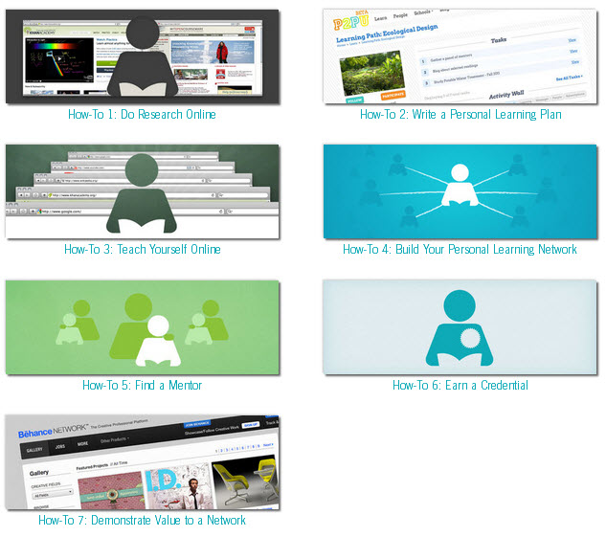
DIY Statistics
Notes:
There are over 300 “Do It Yourself” App in the I-Tunes Application Store. The concept has applicability to higher education.

Slide 20
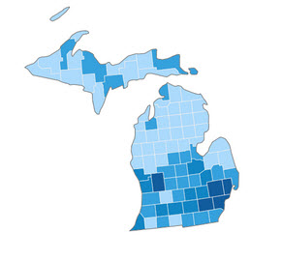
Demographics
Notes:
“Demographics is Destiny”

Slide 21
Michigan Population Between 2009 and 2014
The State lost 100,573 residents
Those residents 0 to 24 years old declined by 162,177
Those aged 15 to 19 declined by almost 74,000 residents
Those residents 25 to 64 years old declined by only 95,532
Those aged 55 to 64 increased by 156,219
Notes:
Michigan’s out migration coupled with a baby bust partly explains our current enrollment crisis.

Slide 22
Michigan Population 2014
The State’s Population has increased slowly over the last 2 years.
Those residents 0 to 24 years old make up 32% of the population
Those residents 25 to 64 years old make up 52% of the population
Notes:
However, using resources to recruit the larger portion of the population may increase enrollments.

Slide 23
Michigan’s Population Implications
Traditionally-aged students will continue to be scarce
Exacerbates enrollment decline
Opportunities exist in recruiting non-traditional aged students
Unemployed and Underemployed
Skills upgrade and retraining
Second and Third Careers
Notes:
Directing resources to recruit and serve the non-traditional student may have a positive effect on enrollment.

Slide 24
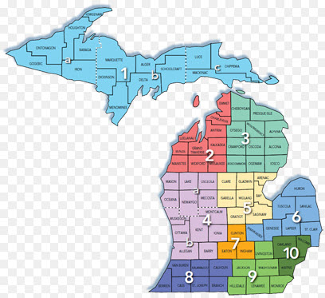
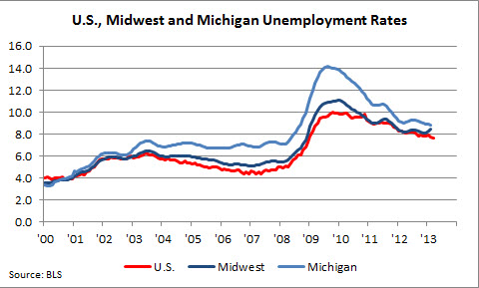
A Brief, but Important Word About Michigan’s Employment Picture
Notes:
Michigan workers have not had an easy road in the recent past and recovery is painfully slow.

Slide 25
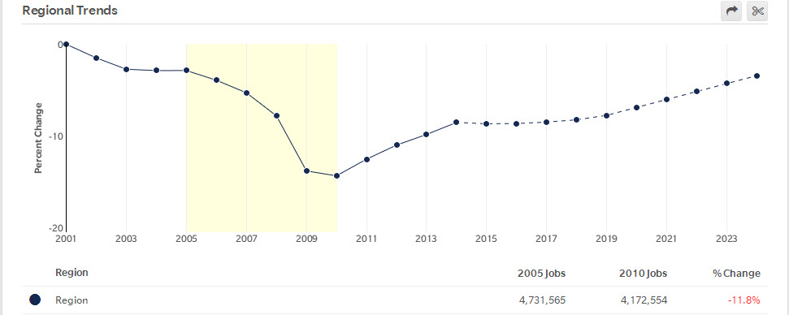
Michigan Jobs 2005 - 2010
559,011 Jobs Lost
Notes:
Community colleges have the opportunity to speed economic recovery by decreasing the skills gap that exists in our communities. Community Colleges have the opportunity to raise 2015 employment and beyond.

Slide 26
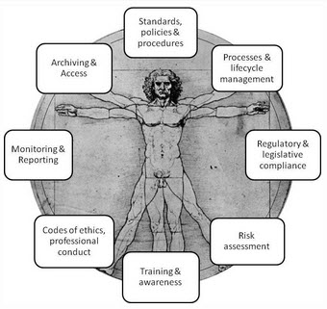
Governance
Notes:
Governance regulates change.

Slide 27
Governance
Regulates and provides for a smooth integration of technological and policy change
Bottleneck to change, slowing and sometimes stalling the impact new technologies or policies
Federal, State, and Local Government
Accrediting Agencies
CC Board of Trustees
Notes:
Governance is more that just government.

Slide 28
Governance
Responsible for:
Public and College Policy
Accountability Agenda
And
Issues such as:
The proper use of technology in education
Liberal Arts vs Workforce Education
Credit vs Non-Credit courses and program
The value of a college education

Slide 29
The Problem with College for Everyone
How does the public define “college”?
Notes:
The press and the public have continued to question the value of a “college” education,

Slide 30
The Problem with “College” for Everyone
When the media writes about “College”, they usually mean a 4 to 6 year degree called the Bachelor’s Degree
Liberal Arts
High Tuition Costs
High Student Loan Debt
Lack of an Employable Skill
Poor Job prospects
Most jobs needed in the next 10 years will Not need a college degree…

Slide 31
The Problem with “College” for Everyone
…But will need some college or an Associates Degree
Registered nurses
Secretaries and administrative assistants, except legal, medical, and executive
Bookkeeping, accounting, and auditing clerks
Medical secretaries
Licensed practical and licensed vocational nurses
First-line supervisors of office and administrative support workers
Medical assistants
Sales representatives, wholesale and manufacturing, except technical and scientific products
Nursing Assistants

Slide 32
The Problem with “College” for Everyone
Community Colleges must Distinguish themselves as the “College” that:
Prepares Students for the Workplace
Curriculum Aligned with the Community’s Workforce
Certificates of Completion
Stackable Credentials
Internships
Prepares Students to Transfer into Degree Programs at 4-yr Institutions with the Promise of Employment
STEM Fields
Or Both

Slide 33
Community Colleges have enjoyed great press and opportunities for additional funding since the end of the Great Recession.
With Greater Recognition and Funding (Power),
Comes Great Responsibility
Notes:
A cautionary note emphasizing the pressure to deliver a well educated and trained workforce.

Slide 34
Michigan Community Colleges have Great Opportunities and Challenges as they Face the Future,
However, Each College has the Opportunity to Create its Own Future or Futures.

Slide 35
Contact
Mark Champion, Information Analyst
Institutional Research and Planning
Grand Rapids Community College
Grand Rapids, Michigan
mchampio@grcc.edu

