Slide 1
IPEDS Data Center – How To
Michigan Community Colleges Data Workshop, August 2, 2013
PRESENTED BY: Eileen Brennan, Oakland Community College

Slide 2
IPEDS Data Center – How To
Michigan Community Colleges Data Workshop, August 2, 2013
INFORMATION PRESENTED INCLUDES SUMMARIES OF INFORMATION AND GRAPHICS COMPILED BY THE ASSOCIATION FOR INSTITUTIONAL RESEARCH (AIR) AND AVAILABLE THROUGH AIR’S WEB SITE, AIRWEB.ORG.
Notes:
We now have four trainers from Michigan:
Eileen Brennan (Oakland Community College)
Lakia Hairston (P&A Scholars Beauty School) lakiahairston@comcast.net
Alissa Sheftic (Glen Oaks Community College) asheftic@lakemichigancollege.edu
Tim Yount (Baker University) tim.yount@baker.edu

Slide 3
IPEDS Data Center – How To
OBJECTIVES:
Explore resources available to enhance your knowledge of how to use the Data Center.
Discuss the difference between “Publicly Released Data” and “Early Release Data.”
Explore ways to obtain data.
Learn how to save a Comparison Group.
Review the Custom Data Feedback Report.
Notes:
Not all slides in this PowerPoint document will be reviewed during the presentation. However, the document will be available on the MCCNET website after the workshop so that participants and others can use the information as needed as they explore the IPEDS Data Center.

Slide 4
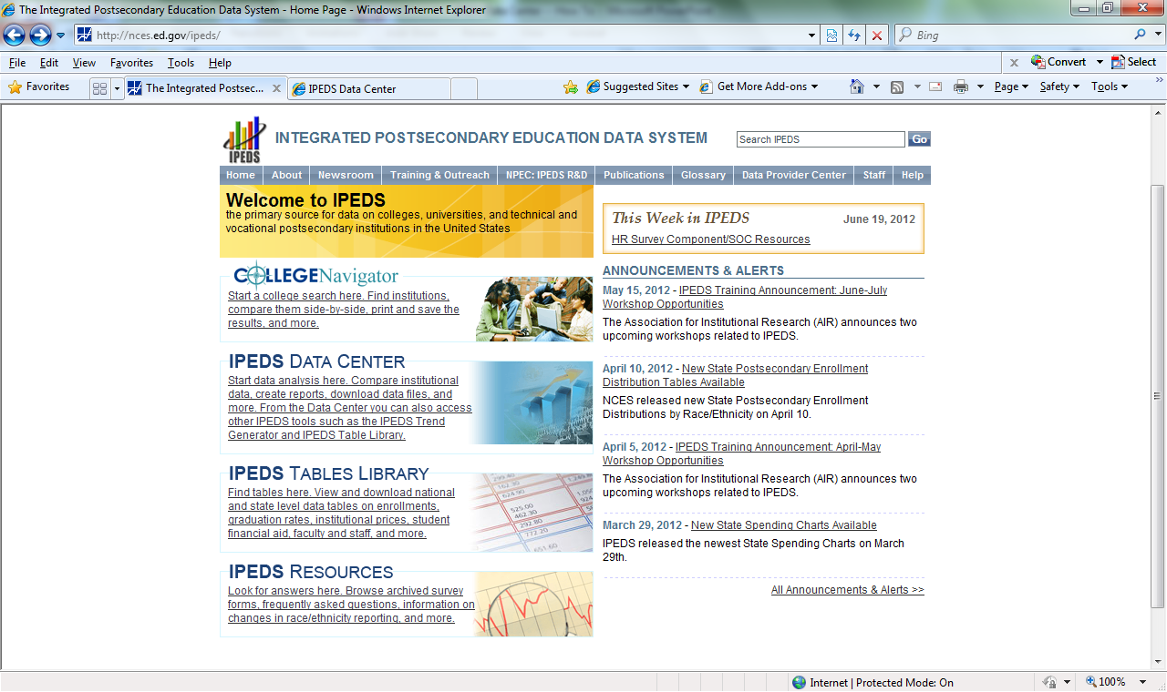
IPEDS Data Center – How To IPEDS Data Center User Manual, Step One nces.ed.gov/ipeds
Notes:
Open the main IPEDS page, then choose the link to IPEDS Resources.

Slide 5
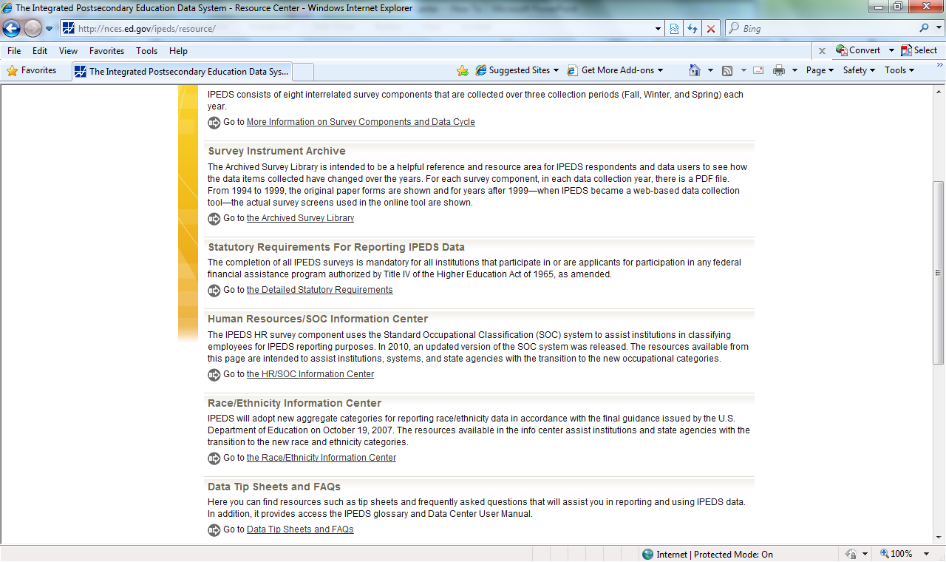
IPEDS Data Center – How To IPEDS Data Center User Manual, Step Two nces.ed.gov/ipeds
Notes:
Choose the Data Tip Sheets and FAQs hyperlink at the bottom of the page.

Slide 6
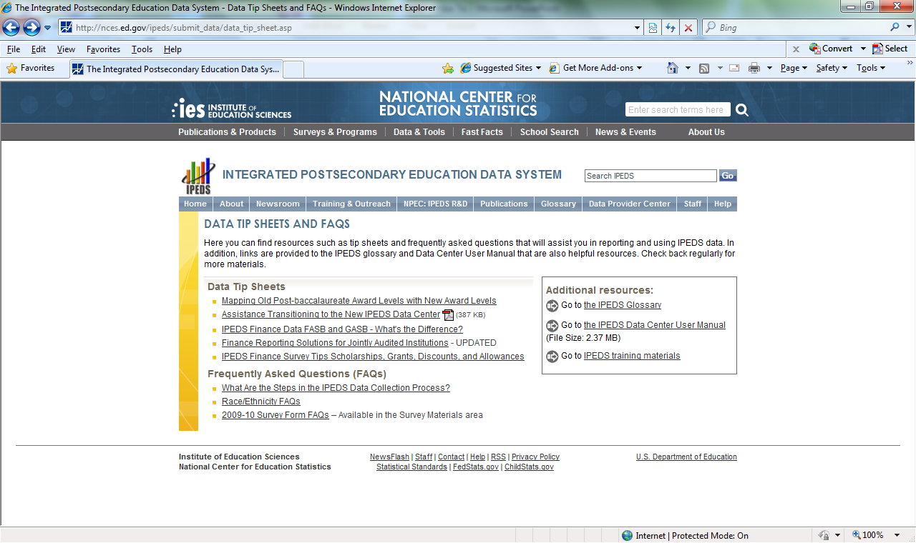
IPEDS Data Center – How To IPEDS Data Center User Manual, Step Three nces.ed.gov/ipeds
Notes:
Choose the link “Go the IPEDS Data Center User Manual.” Note that there are many other resources available to explore!
This manual is also available directly in the Data Center under the help menu.

Slide 7
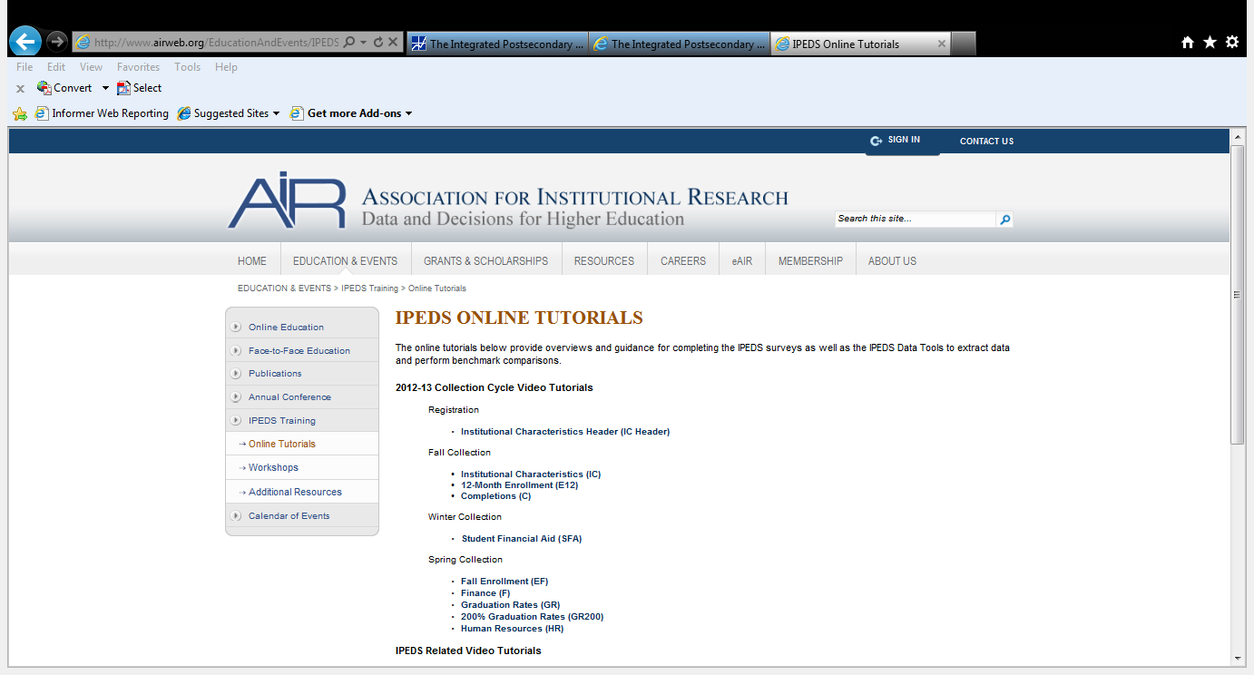
IPEDS Data Center – How To IPEDS Data Center Tutorial http://www.airweb.org/EducationAndEvents/IPEDSTraining/Tutorials
Notes:
http://www.airweb.org/EducationAndEvents/IPEDSTraining/Tutorials
There are five video tutorials available: Overview, Getting Started, Comparison Groups, Ranking Report, and Pre-defined Reports. The longest of these is less than ten minutes!

Slide 8
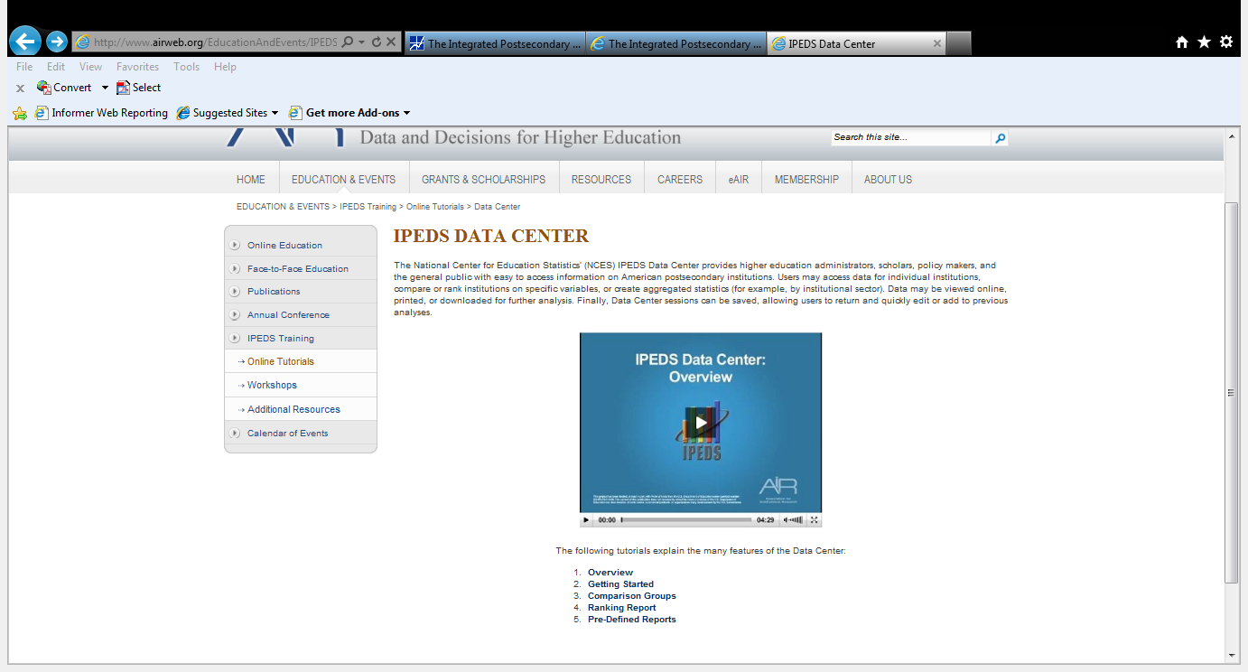
IPEDS Data Center – How To IPEDS Data Center Tutorial http://www.airweb.org/EducationAndEvents/IPEDSTraining/Tutorials
Notes:
Each module takes only a few moments to watch. As of the creation of this PowerPoint, it was noted that Download PDFs are coming soon.

Slide 9
IPEDS Data Center – How To nces.ed.gov/ipeds/datacenter
Notes:
Now that we’ve reviewed resources to help you with the Data Center, here is how you access it. You can enter the web-site http:/nces.ed.gov/ipeds and choose the IPEDS Data Center hyperlink, or enter nces.ed.gov/ipeds/datacenter.

Slide 10
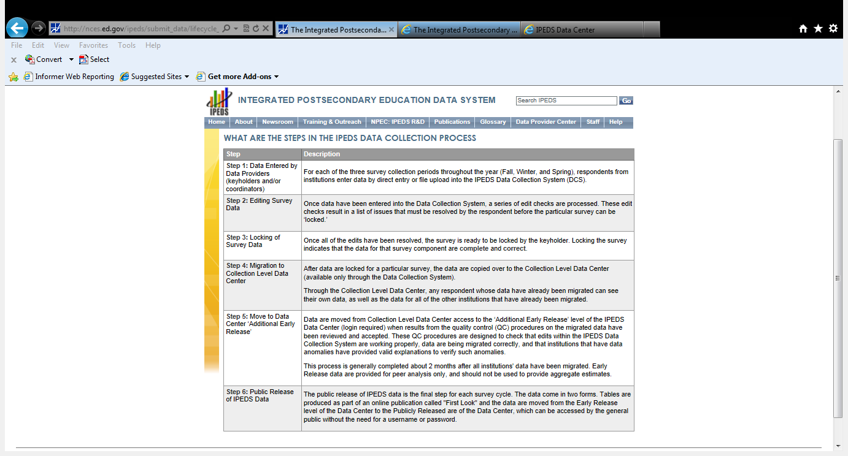
IPEDS DATA CENTER – HOW TO WHEN DO I ACCESS THE DATA? nces.ed.gov/ipeds/submit_data/lifecycle_text.asp
Notes:
This tip sheet explains how IPEDS data are made available.
Publicly released data are the most “clean” data, and are generally the data available from the data collection cycle from the previous year. Early release data are not “imputed,” and subject to some changes. Generally, they are from the most recent data collection cycle. These data are not the data used in NCES reports because they are subject to additional analysis and review.
There are two levels of data available: publicly released data and additional early release data. Publicly released data include all of the years of data collected that have been analyzed, reviewed and made available in First Look Publications. The latest year available is generally the one prior to the latest data collection cycle. Additional early release data “includes access to publicly released data as well as early release data.” Early release data are those data recently submitted through the data collection process acceptable through the quality control processes. “The early release files are provided for institutional level analysis only, and should not be used for national, state, or other aggregate estimates.”
Once in the Data Center users are prompted to select Publicly Released Data or Additional Early Release Data. Accessing Early Release Data requires a login and password. The most recent year of data by survey are indicated on the screen.

Slide 11
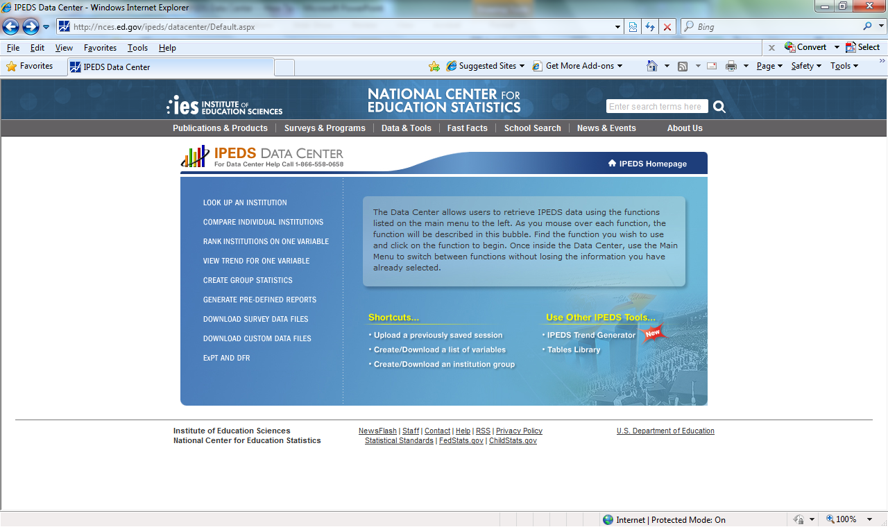
IPEDS DATA CENTER – HOW TO HOW DO I ACCESS THE DATA?
Notes:
With the exception of ExPT (Executive Peer Tool) and DFR (Data Feedback Report) you will be asked whether you want to access Provisional Release Data or Preliminary Release Data. Choose any of the links (except for ExPT and DFR) and you will be provided your choice.

Slide 12
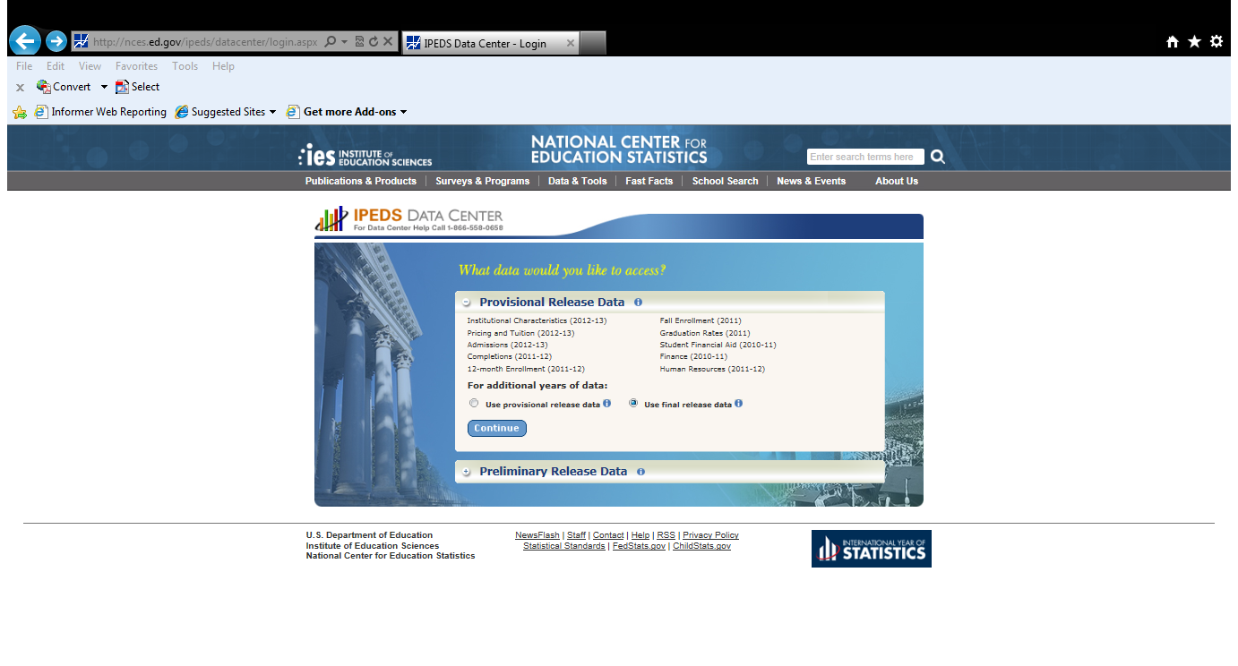
IPEDS DATA CENTER – HOW TO WHEN DO I ACCESS THE DATA? Sign up to gain access to Early Release Data
Notes:
This screen shot is based on choosing the hyperlink for “Look Up an Institution.” Note that there are hyperlinks for Provisional Release Data and Preliminary Release Data. Note that the most recently available years of data are noted next to the survey. ADDITIONAL EARLY RELEASE or PRELIMINARY RELEASE DATA WERE NOT AVAILABLE AS OF THE END OF JULY 2013, SO THIS OPTION WAS NOT AVAILABLE.
Note that a default selection chooses Final Release Data. By clicking on the information link for provisional release or final release data the user will get a message that preliminary release data are those originally submitted by institutions in the given collection year, and may not be reflected in published NCES tables, while revised data will reflect as best as possible any revisions submitted by institutions after the initial collection cycle.
THIS SCREEN SHOT WAS TAKEN IN JULY 2012. AS OF JULY 2013 THERE WERE NO PRELIMINARY RELEASE DATA.

Slide 13
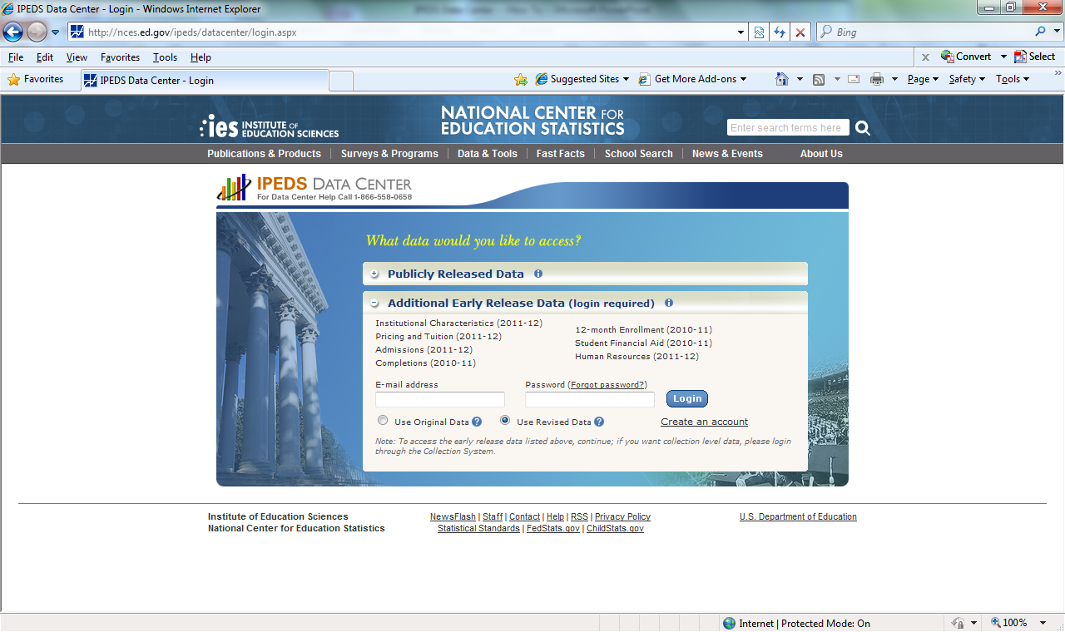
IPEDS DATA CENTER – HOW TO HOW DO I ACCESS THE DATA? Sign up to gain access to Early Release Data
Notes:
If you have not done so, and would like access to Early Release Data, now called Preliminary Release Data, create an account. You will be asked to provide an e-mail, and the account set-up will be sent to that e-mail. NOTE THAT THIS SCREEN SHOT WAS TAKEN DURING 2012 AS THERE WERE NO PRELIMINARY RELEASE DATA AVAILABLE AT THE END OF JULY 2013.
Additional early release data includes access to publicly released data as well as early release data. The early release files are provided for institutional level analysis only, and should not be used for national, state, or other aggregate estimates. Years in parentheses indicate the most recent early release data available.

Slide 14
IPEDS DATA CENTER – HOW TO WHAT DATA DO I WANT?
Notes:
The Data Center provides many ways to access data. When using the Data Center Live, hovering over any selection will provide more explanation. (The next slide will provide an example).

Slide 15
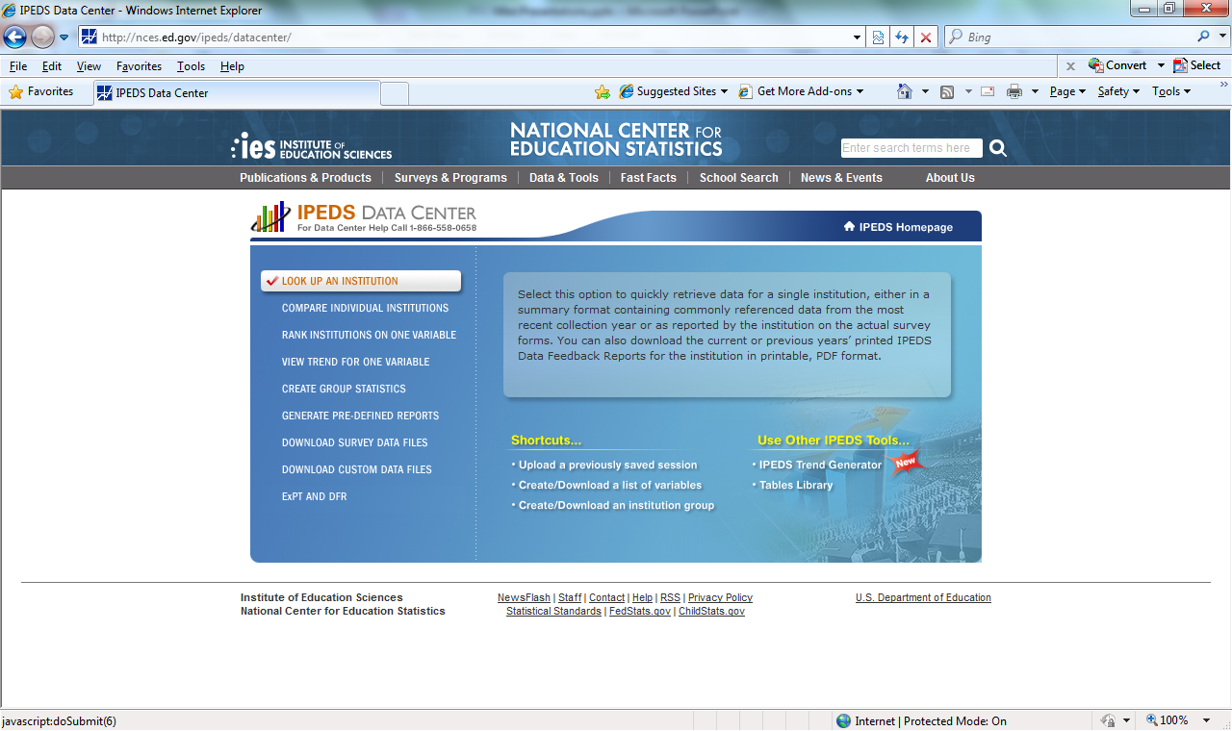
IPEDS DATA CENTER – HOW TO WHAT DATA DO I WANT?
Notes:
Note that the text box on the right changes by hovering over a selection. The majority of the options will provide institution level data by institutions selected. “Create Group Statistics” provides the statistics selected for the group. The DFR (Data Feedback Report) link will provide charts comparing the average statistics for the comparison group selected to the comparison institution selected.

Slide 16
IPEDS DATA CENTER – HOW TO WHOSE DATA DO I WANT?
Notes:
You can save a comparison group before you begin, or later in the process. To set up a comparison group before you access data choose the “Create/Download an institution group” link under the Shortcuts menu.

Slide 17
IPEDS DATA CENTER – HOW TO WHOSE DATA DO I WANT?
Notes:
Note that there are several methods available for selecting a comparison group. With the “By Names or UnitIDs” option the user can enter individual institutions. EZ Group offers the options of selecting by categories. For example, in EZ groups a user could select all Michigan Community Colleges by choosing the State of Michigan, and the Public 2-Year sector. One of the tutorials provides step-by-step instructions on how to use EZ group. A user can also select a comparison group based upon common data reported in IPEDS variables (By Variables).
The “By Uploading a File” option allows selection by a saved comparison group.

Slide 18
IPEDS DATA CENTER – HOW TO WHOSE DATA DO I WANT?
Notes:
This slide, and the next nine slides demonstrate selecting a comparison group by Institution Name, and saving that list. After clicking on the short cut to “Create/Download an institution group” the user will be prompted to choose publicly released or early access data. Either option will work in creating the saved comparison group. The next choice is “1. Select Institution.” Typing in even a few characters of the institution name will set up a drop-list of institutions.

Slide 19
IPEDS DATA CENTER – HOW TO WHOSE DATA DO I WANT?
Notes:
By typing in “oakland” a drop down list appeared. For purposes of this example, Oakland Community College was chosen.

Slide 20
IPEDS DATA CENTER – HOW TO WHOSE DATA DO I WANT?
Notes:
After selecting Oakland Community College, the IPEDS id, name, city and state appear in “My Institutions.” To select another institution click on “By Names or UnitIDs.”

Slide 21
IPEDS DATA CENTER – HOW TO WHOSE DATA DO I WANT?
Notes:
By typing in “Macomb,” Macomb Community College appears in the drop-down list. Macomb Community College is selected.

Slide 22
IPEDS DATA CENTER – HOW TO WHOSE DATA DO I WANT?
Notes:
Now two institutions appear in the “My Institutions.”

Slide 23
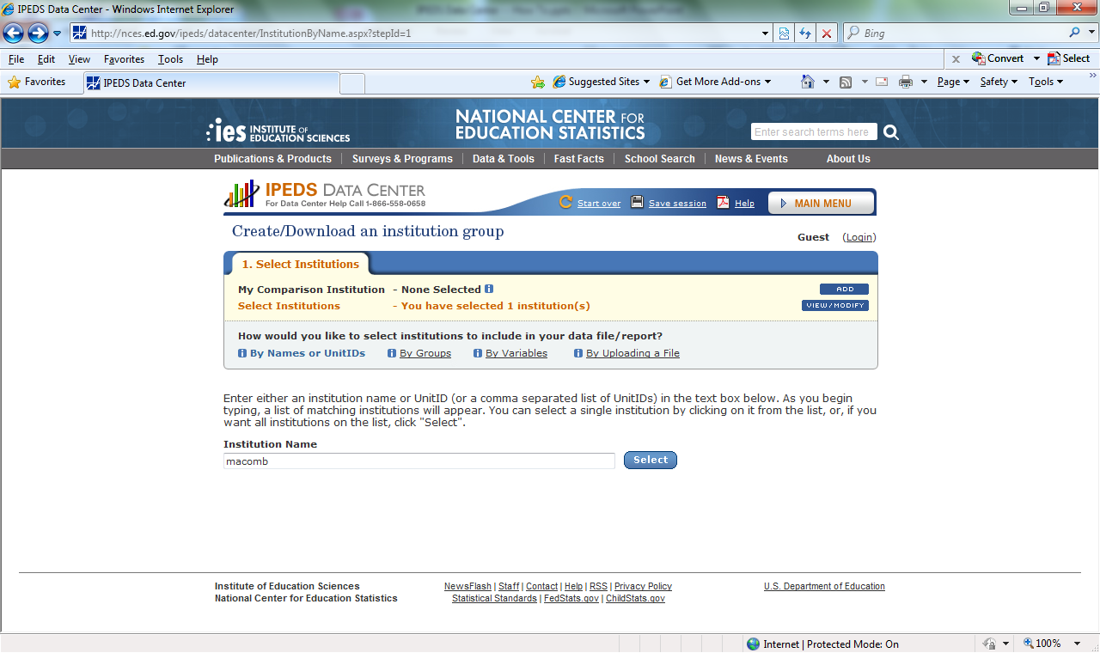
IPEDS DATA CENTER – HOW TO WHOSE DATA DO I WANT?
Notes:
However, no Comparison Institution was selected. To select a comparison institution choose the Add link on the My Comparison Institution line.

Slide 24
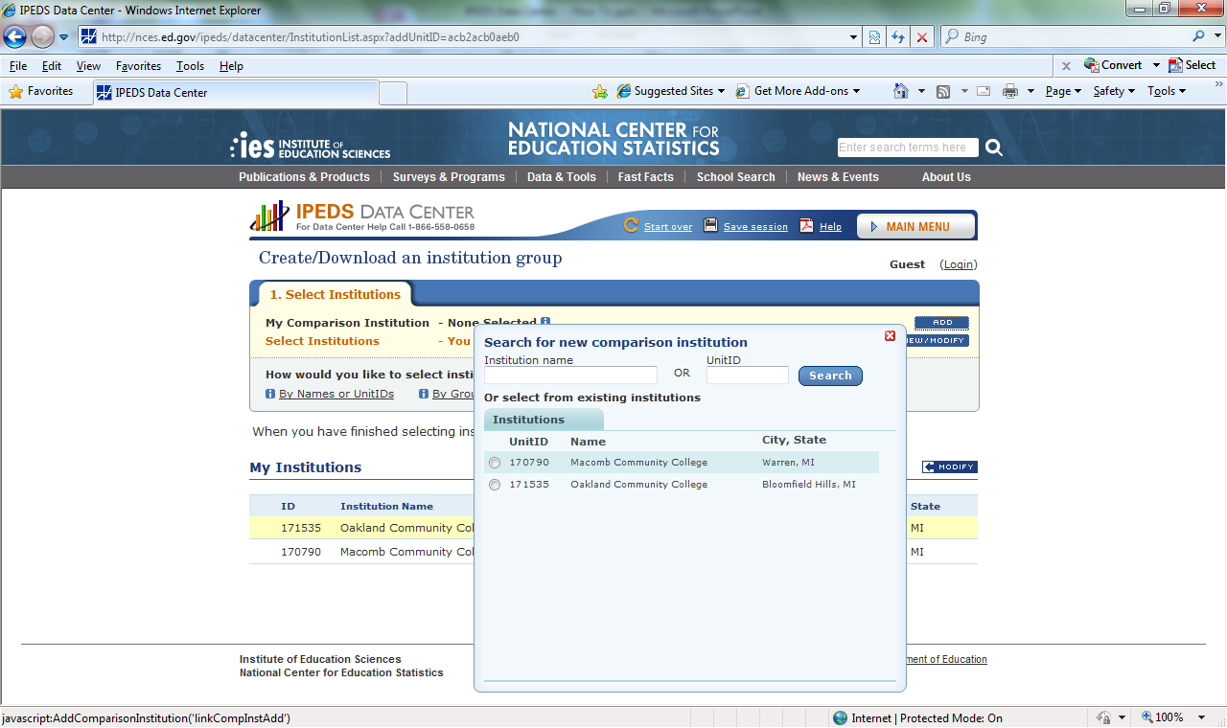
IPEDS DATA CENTER – HOW TO WHOSE DATA DO I WANT?
Notes:
Note that after choosing the Add My Comparison Institution link a prompt screen appears allowing for choosing one of the institutions already selected, or entering a new institution.

Slide 25
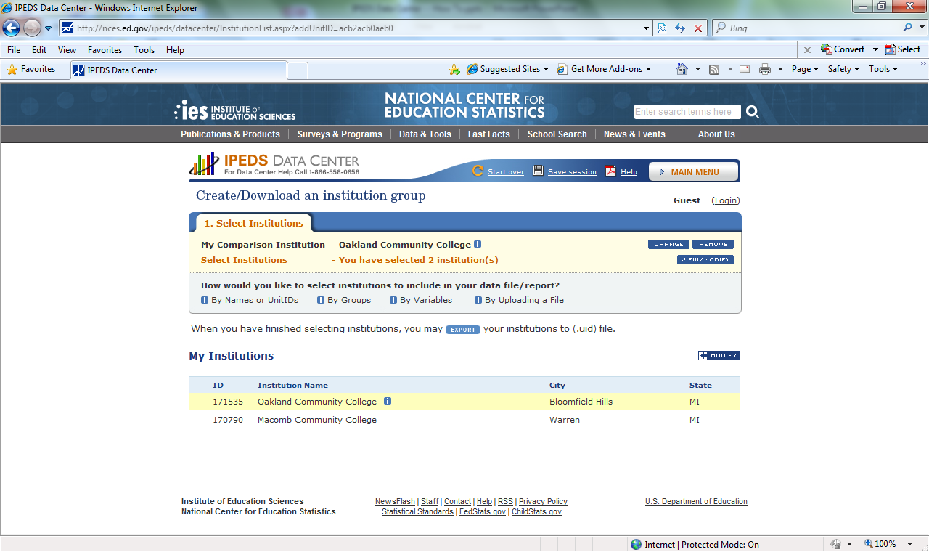
IPEDS DATA CENTER – HOW TO WHOSE DATA DO I WANT?
Notes:
Note that Oakland Community College is now the Comparison Institution. Repeat the steps of choosing institutions to get the other institutions desired for the comparison group.

Slide 26
IPEDS DATA CENTER – HOW TO WHOSE DATA DO I WANT?
Notes:
An institution list composed of OCC’s neighbors has been produced. Now, this list can be saved by choosing the Export option.

Slide 27
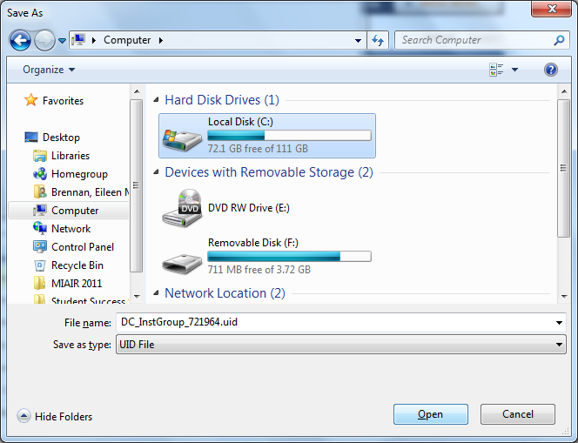
IPEDS DATA CENTER – HOW TO WHOSE DATA DO I WANT?
Notes:
The user is prompted to open, save or cancel. When saving the list note that the extension for the file is “uid.” Do not change the extension. This file type must be maintained to later upload the saved comparison group.

Slide 28
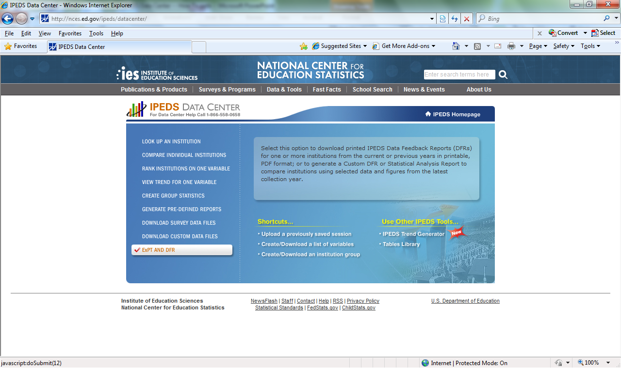
IPEDS DATA CENTER – HOW TO Data Feedback Reports
Notes:
The chief officer and the keyholder of every institution receive a copy of the Data Feedback report each year in October. The Data Feedback Report provides charts comparing the institution to a comparison group either selected by the institution or selected through a formula using such factors as Carnegie classification, enrollment, and geographical setting. Chart topics include information about student enrollment, staff, and finances selected by a Technical Review Panel.
The Data Feedback Report can be replicated using the ExPT AND DFR tool, using either the institution’s selected comparison group (or the default selected by IPEDS) or another comparison group chosen by the user.

Slide 29
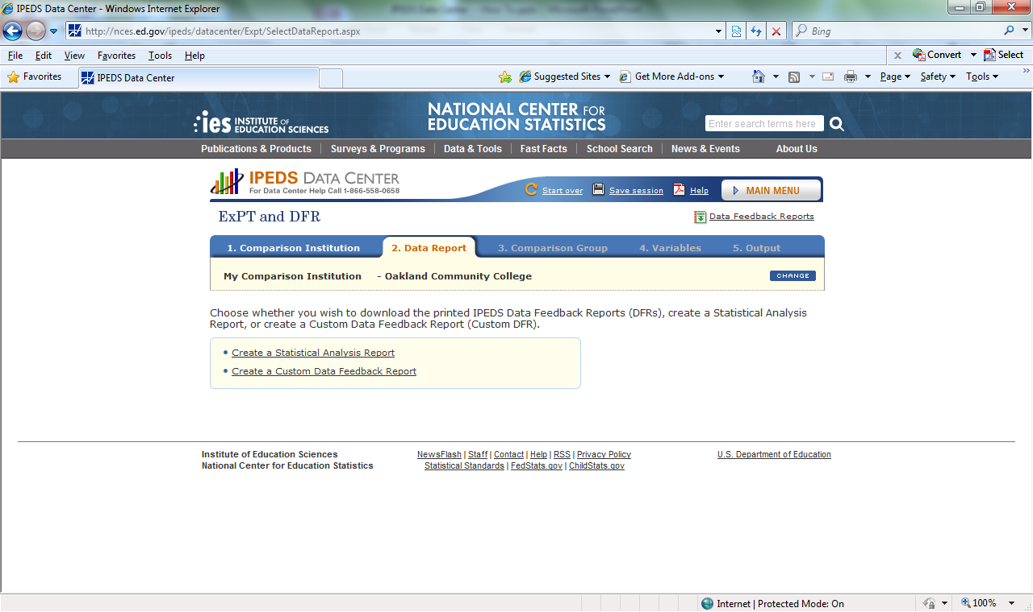
IPEDS DATA CENTER – HOW TO Data Feedback Reports
Notes:
By choosing the ExPT AND DFR link this screen appears. Note that a comparison college has been selected.
There are two options available. Choosing “Create a Custom Data Feedback Report” creates a Data Feedback Report with the comparison group the user chooses. Choosing “Create a Statistical Analysis Report” allows the user to choose which data to view. The data are then available in charts comparing the comparison institution to the group, and as data tables showing the data for each school in the comparison group.

Slide 30
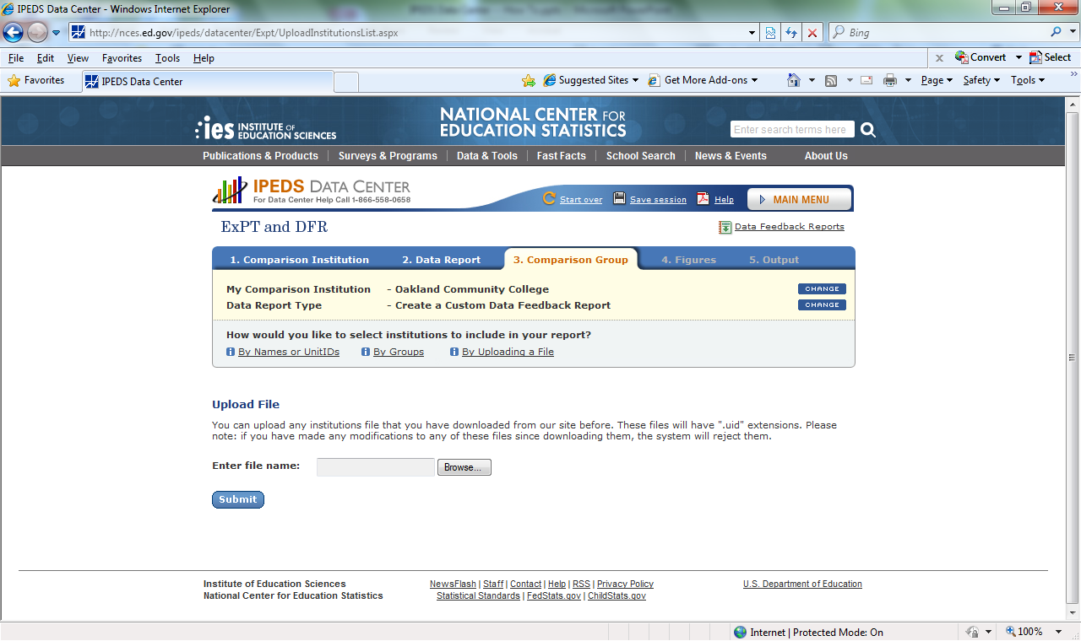
IPEDS DATA CENTER – HOW TO Data Feedback Reports
Notes:
The “Create a Custom Data Feedback Report” link has been chosen here. At this point the user can choose to create an institution list, use EX Group, or Upload a File. At this point, Upload a File has been chosen, the user prompted to log in, and the prompt to enter the saved comparison list provided. Remember, in the section on Comparison Groups, a Comparison Group was saved WITH A .UID EXTENSION! That file was uploaded before setting up the next screen.

Slide 31
IPEDS DATA CENTER – HOW TO Data Feedback Reports
Notes:
Note that the institution list is populated with the institutions from the save list. The next step is to click continue to select what data from the Data Feedback Report the user wants.

Slide 32
IPEDS DATA CENTER – HOW TO Data Feedback Reports
Notes:
A list of the variables available in the Feedback Report appears. The list on this slide is available through the screen print. Scrolling down on the actual web page allows viewing additional variables. Users are given the option of selecting all variables, choosing among the variables available, or selecting only the variables printed in the Data Feedback Report. Note that all data are Fall 2011, or the 2010-11 academic year. Your keyholder and chief executive will have received a Data Feedback Report with Fall 2012 and 2011-12 academic year data.
For purposes of this demonstration the following variables are chosen: Unduplicated 12 Month Enrollment, Student to Faculty Ratio, Percent of all Undergraduates Receiving Aid by type, and Percent distribution of core expenses by function.

Slide 33
IPEDS DATA CENTER – HOW TO Data Feedback Reports
Notes:
The first chart appears, as well as a prompt to download the document as a PDF file.
Note the link to download Data Feedback Reports in the upper right corner of the screen. Using this link, a list of years for which this report is available appears, and the user can choose to download other years.

Slide 34
IPEDS DATA CENTER – HOW TO Data Feedback Reports
Notes:
The “Create a Statistical Analysis Report” link has been chosen here by clicking the MAIN MENU link, choosing Custom DFR link, and choosing the “Create a Statistical Analysis Report” link. For purposes of this demonstration only the Unduplicated 12 Month Enrollment
variable was chosen.

Slide 35
IPEDS DATA CENTER – HOW TO Data Feedback Reports
Notes:
The “Create a Statistical Analysis Report” link has been chosen here by clicking the MAIN MENU link, choosing Custom DFR link, and choosing the “Create a Statistical Analysis Report” link. For purposes of this demonstration only the Unduplicated 12 Month Enrollment
variable was chosen. All elements were chosen.

Slide 36
IPEDS DATA CENTER – HOW TO Data Feedback Reports
Notes:
Note the Statistics and Data Tabs, as well as the Graph icon. Clicking on the Statistics Tab, or allowing the default option, will result in showing the Comparison Institution compared to the Comparison Group. Choosing the graph icon will produce a chart like those produced in the Data Feedback Report. Choosing the Data tab will produce a list of the data by institution.

Slide 37
IPEDS DATA CENTER – HOW TO Data Feedback Reports
Notes:
The data appear after clicking on the DATA tab.

Slide 38
QUESTIONS???
Eileen Brennan
Research Analyst
Office of Institutional Research, Quality and Planning
Oakland Community College
(248) 232-4527
embrenna@oaklandcc.edu

Slide 39
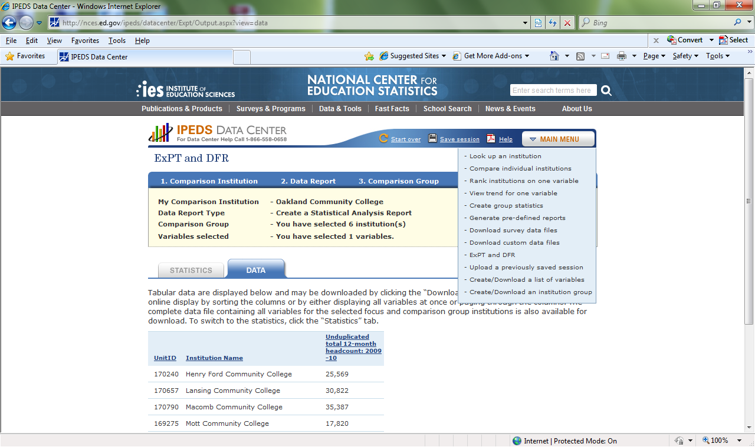
IPEDS DATA CENTER – HOW TO Extras: Compare individual institutions
Notes:
Clicking on the MAIN MENU tab produces a list of all of the options on the initial Data Center screen.
NOTE THAT THIS SCREEN PRINT WAS CREATED IN JULY, 2012. CHANGES MAY HAVE BEEN IMPLEMENTED, INCLUDING DATA AVAILABLE.
HOWEVER, THE GENERAL NAVIGATION AND CONCEPTS REMAIN THE SAME.

Slide 40
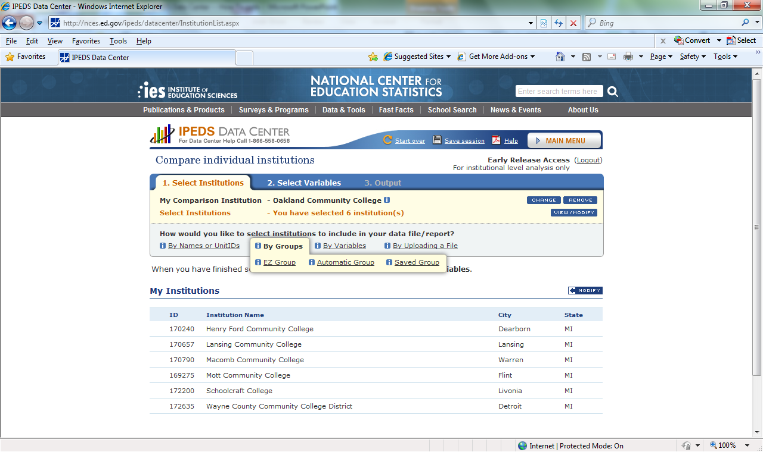
IPEDS DATA CENTER – HOW TO Extras: Compare individual institutions
Notes:
Note that after clicking on the “Compare individual institutions” link in the drop down menu, that title appears near the upper left of the screen. The following ____ slides will show examples of the results.
The user is prompted to confirm or change the comparison group before clicking Continue, to select variables.
NOTE THAT THIS SCREEN PRINT WAS CREATED IN JULY, 2012. CHANGES MAY HAVE BEEN IMPLEMENTED, INCLUDING DATA AVAILABLE.
HOWEVER, THE GENERAL NAVIGATION AND CONCEPTS REMAIN THE SAME.

Slide 41
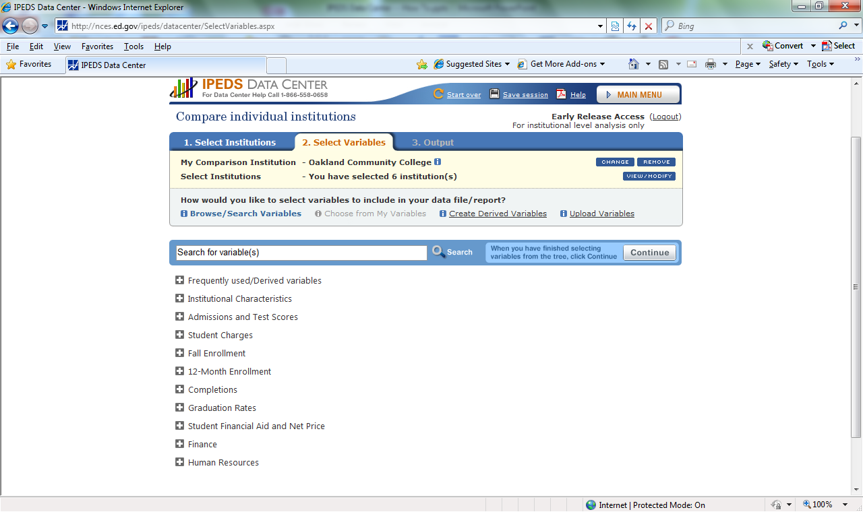
IPEDS DATA CENTER – HOW TO Extras: Compare individual institutions
Notes:
A list of variables appears, including a set of Frequently used/Derived variables. Most variables include an “i” icon. Clicking on the icon produces a description of the variable. It is helpful to have some knowledge of the IPEDS surveys, and in which years they occurred. For example, several HR surveys have changed over the years, with salary by interval mandatory only in select years. Another example is race/ethnicity for both students and staff. The new reporting categories were mandatory for some reports in earlier years than other reports.
NOTE THAT THIS SCREEN PRINT WAS CREATED IN JULY, 2012. CHANGES MAY HAVE BEEN IMPLEMENTED, INCLUDING DATA AVAILABLE.
HOWEVER, THE GENERAL NAVIGATION AND CONCEPTS REMAIN THE SAME.

Slide 42
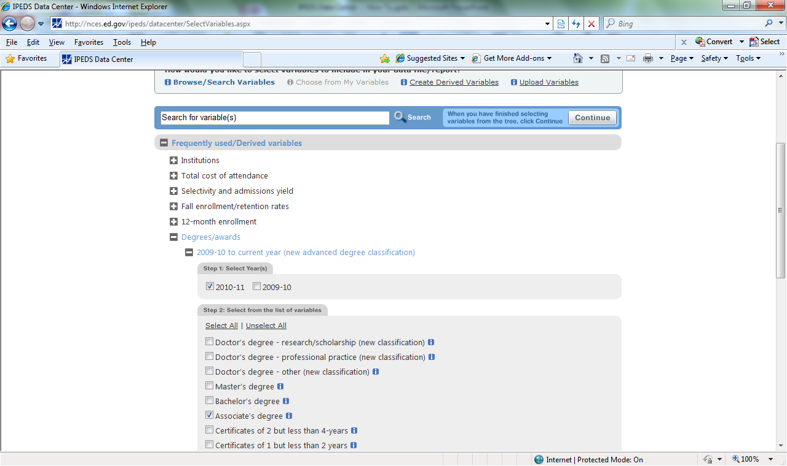
IPEDS DATA CENTER – HOW TO Extras: Compare individual institutions
Notes:
Recalling that the user logged on earlier, so additional early release data is available. In this example the “Frequently used/Derived variables link was selected. “Degrees/awards” were selected, 2009-10 to current year, and Associate’s degree selected as well.
NOTE THAT THIS SCREEN PRINT WAS CREATED IN JULY, 2012. CHANGES MAY HAVE BEEN IMPLEMENTED, INCLUDING DATA AVAILABLE.
HOWEVER, THE GENERAL NAVIGATION AND CONCEPTS REMAIN THE SAME.

Slide 43
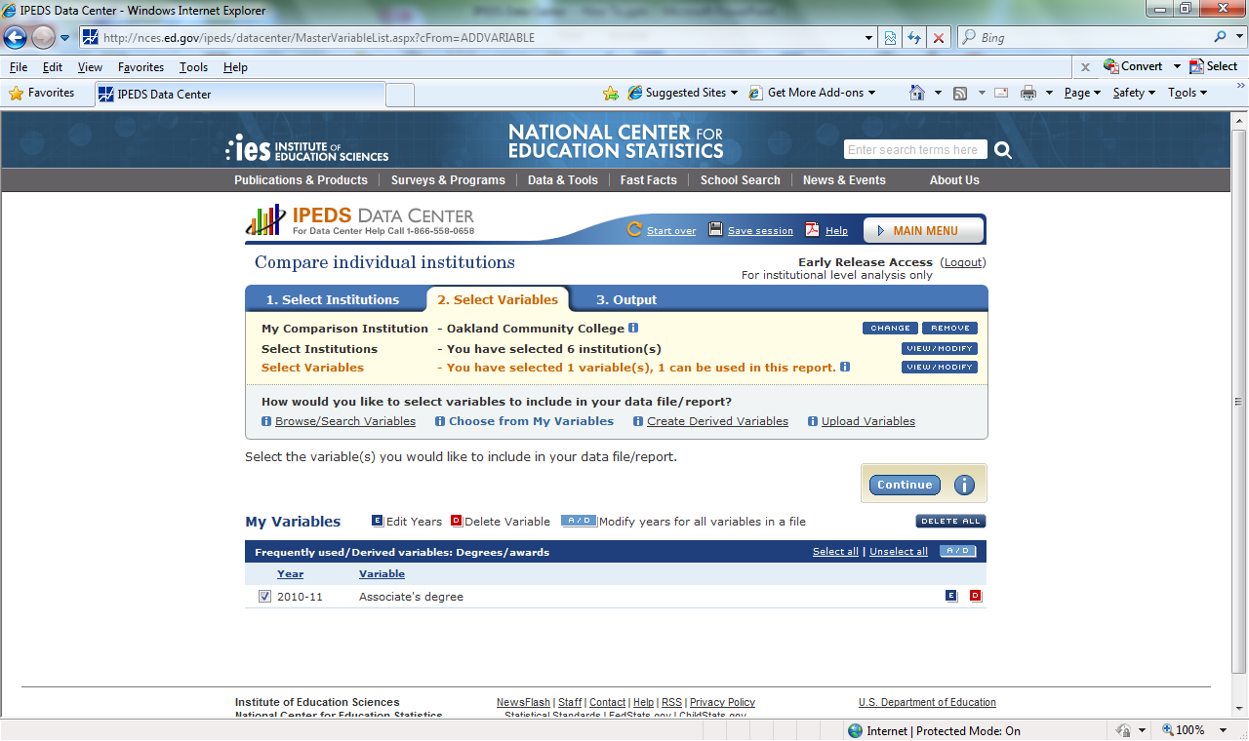
IPEDS DATA CENTER – HOW TO Extras: Compare individual institutions
Notes:
After clicking continue, this screen results. Had multiple variables been selected, the user would have the option of de-selecting some variables or selecting all.
NOTE THAT THIS SCREEN PRINT WAS CREATED IN JULY, 2012. CHANGES MAY HAVE BEEN IMPLEMENTED, INCLUDING DATA AVAILABLE.
HOWEVER, THE GENERAL NAVIGATION AND CONCEPTS REMAIN THE SAME.

Slide 44
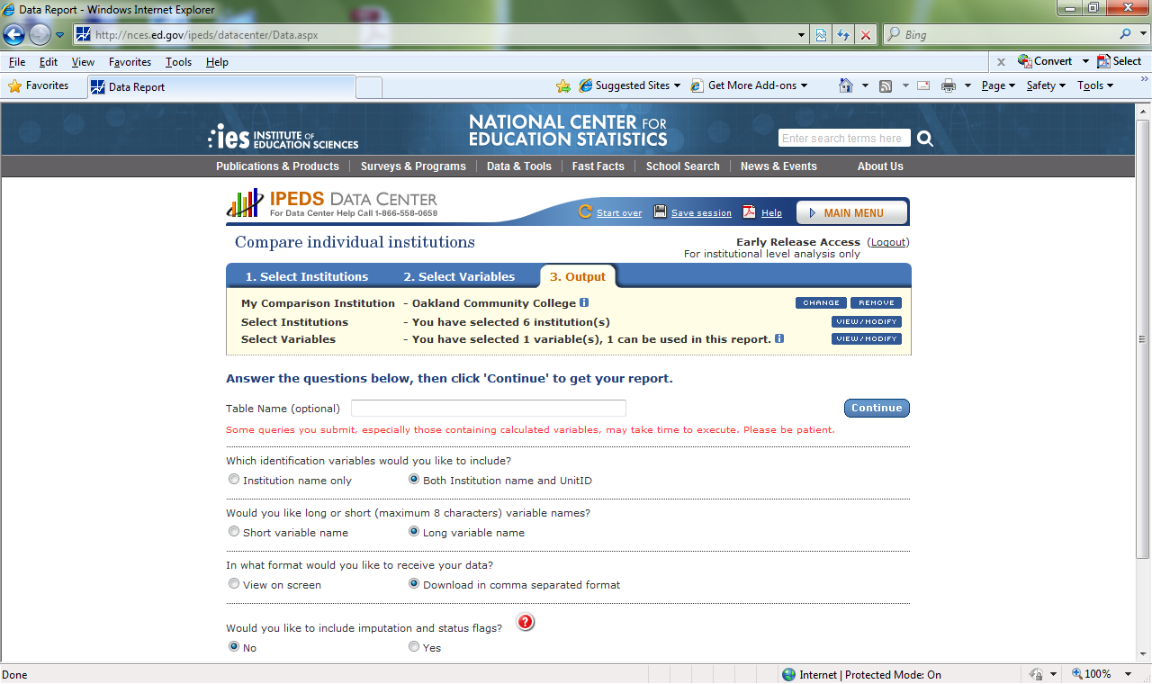
IPEDS DATA CENTER – HOW TO Extras: Compare individual institutions
Notes:
After clicking continue, this screen provides options for the output.
NOTE THAT THIS SCREEN PRINT WAS CREATED IN JULY, 2012. CHANGES MAY HAVE BEEN IMPLEMENTED, INCLUDING DATA AVAILABLE.
HOWEVER, THE GENERAL NAVIGATION AND CONCEPTS REMAIN THE SAME.

Slide 45
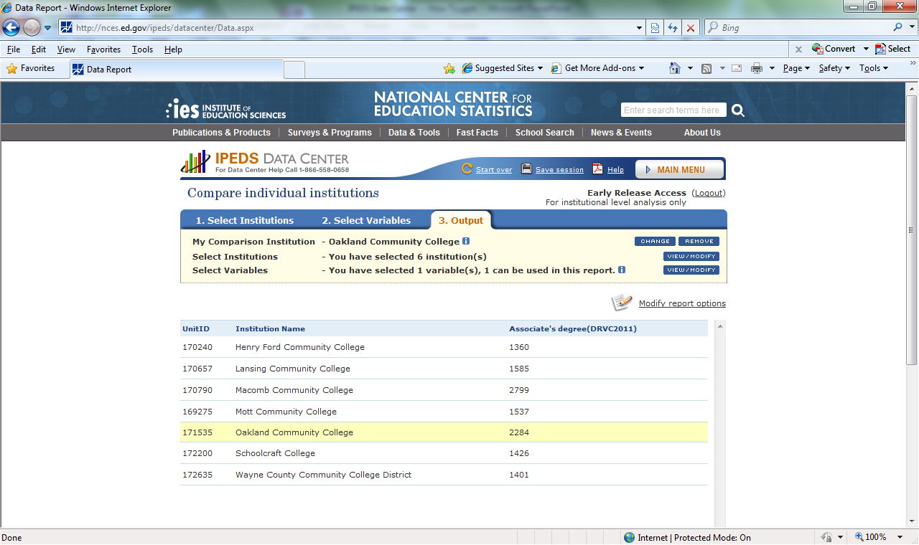
IPEDS DATA CENTER – HOW TO Extras: Compare individual institutions
Notes:
This is an example of the output when “View on Screen” is selected.
NOTE THAT THIS SCREEN PRINT WAS CREATED IN JULY, 2012. CHANGES MAY HAVE BEEN IMPLEMENTED, INCLUDING DATA AVAILABLE.
HOWEVER, THE GENERAL NAVIGATION AND CONCEPTS REMAIN THE SAME.

